Slide 1
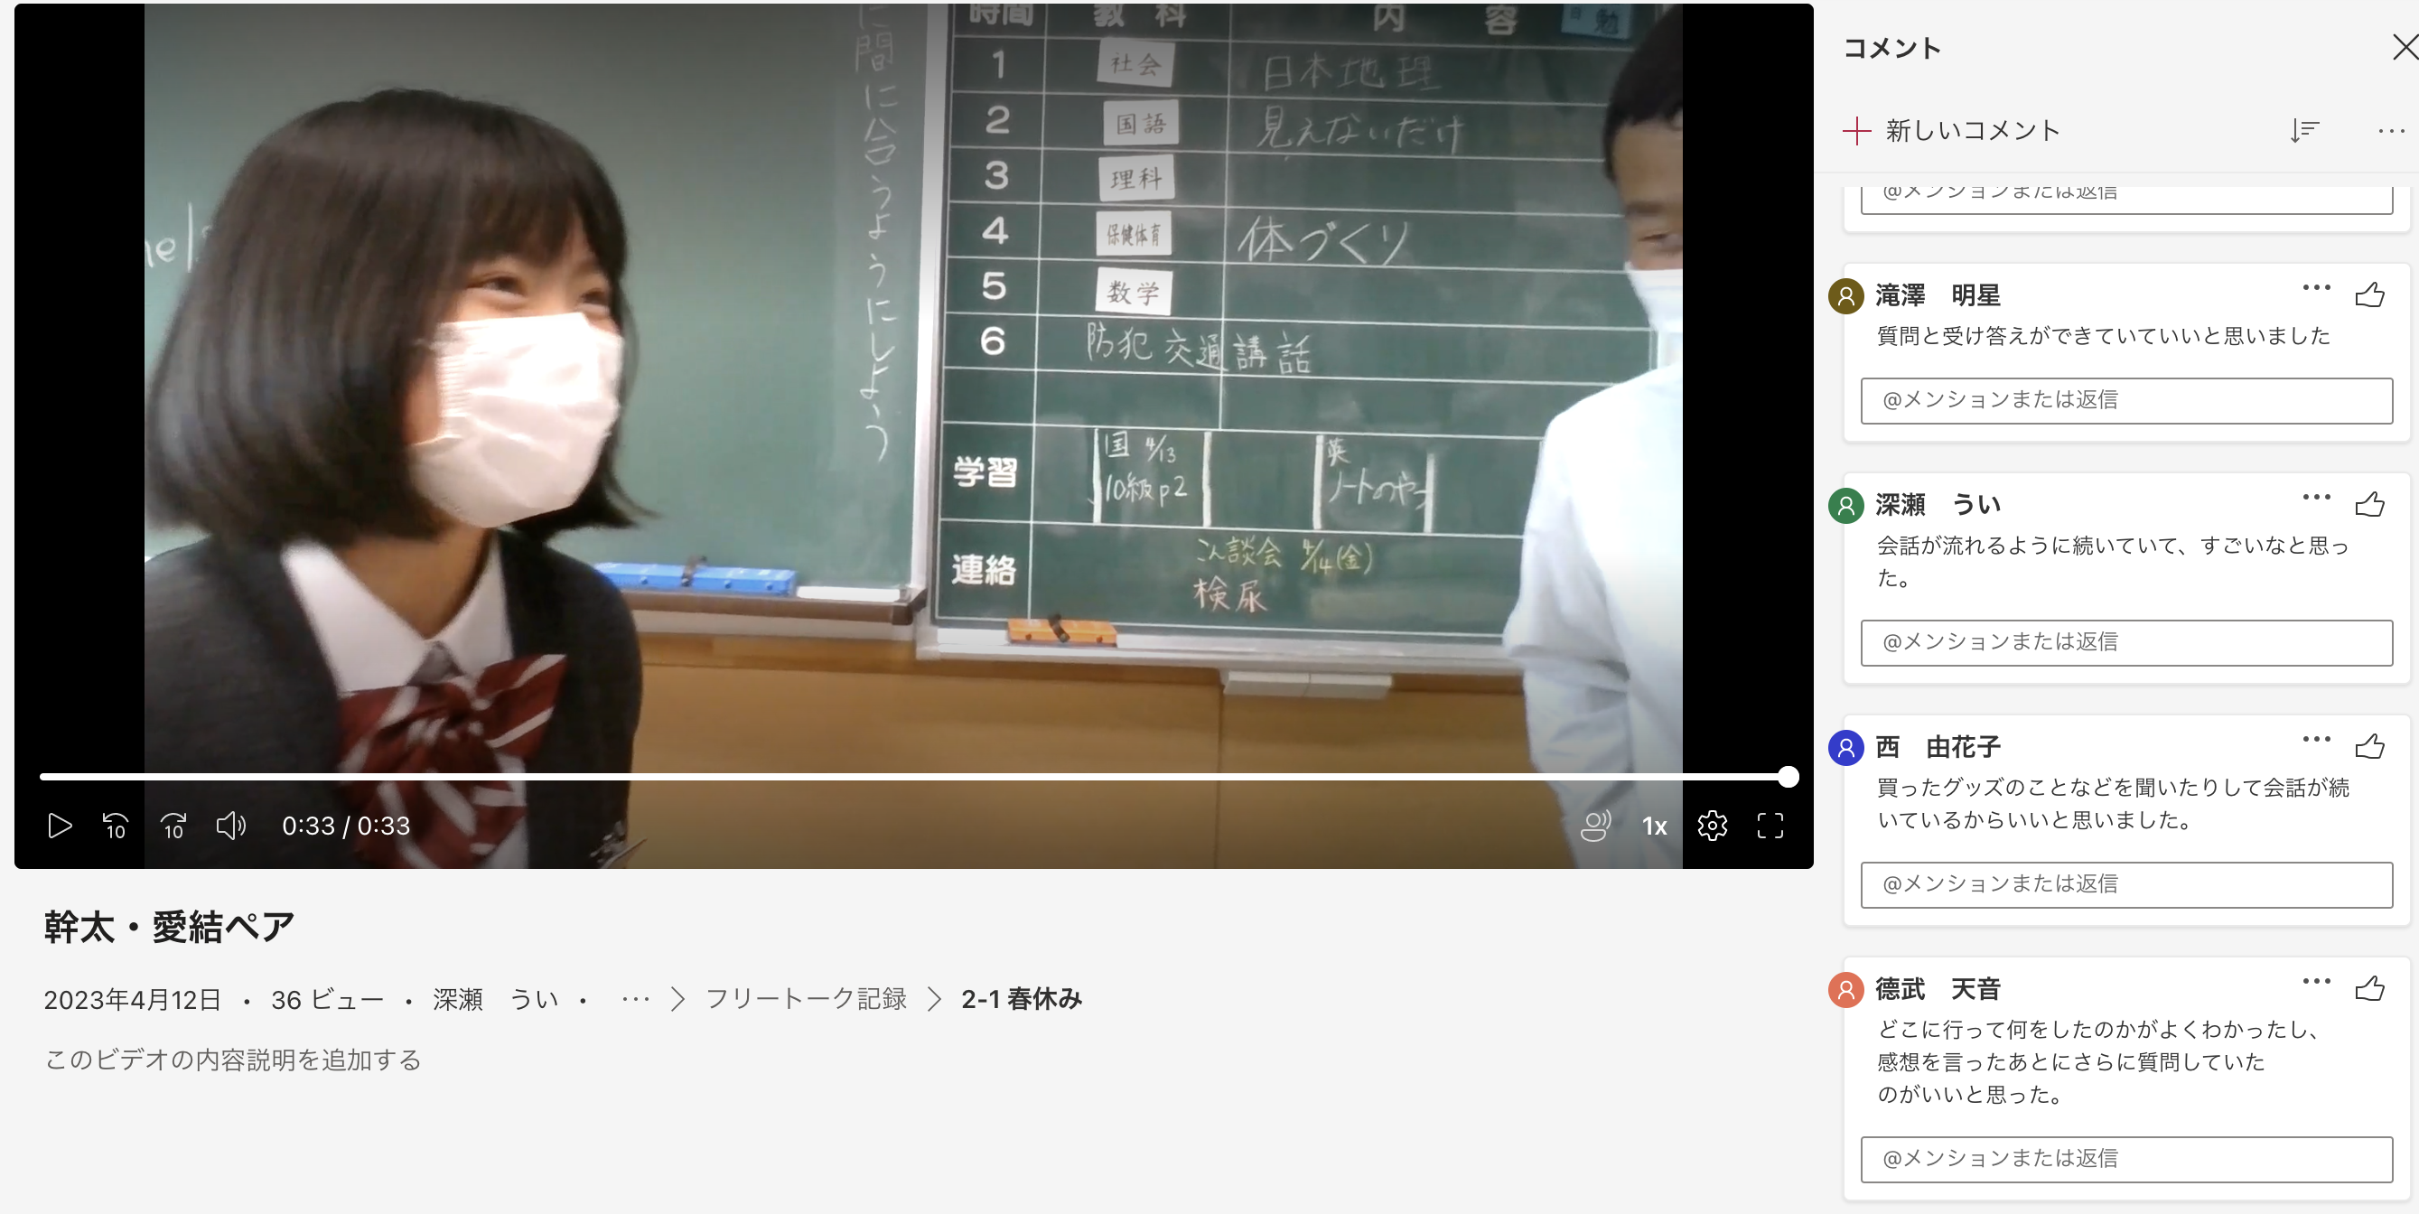

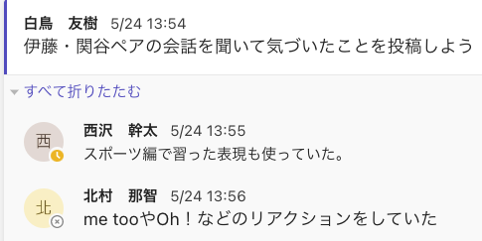
録画機能を活用したやり取りの学び方
友達の会話を見る
A: Do you like comic books?
B: Yes, I do. I like comic books.
A: What kind of comic books do you like?
B: I like sports comic books.
A: What comic books do you like?
B: I like "キャプテン翼”
A: What character do you like?
B: I like Tsubasa. 0h, me, too!
A: Why?
B: Tsubasa is great.
A: Do you like soccer?
B: Yes, I do.
A: Are you good at dribbling?
B: No, I'm not. I'm good at shooting.
マンガ
学んだこと
を投稿
スポーツ
真似して
会話

